Slide 1
Metastatic Gastroesophageal Junctional Cancer
Jennifer Eads, MD
Associate Professor of Medicine
Physician Lead GI Clinical Research
Director, Neuroendocrine Tumor Program
Pennsylvania Society of Oncology and Hematology Annual Scientific Meeting
October 7, 2022
Division of Hematology/Oncology

Slide 2
Case Presentation
63 year old male presents to the ER with two months of difficulty swallowing, now to the point where he is only able to pass small amounts of liquid. Has also sustained a 20 pound weight loss during this time. No pain, N/V or bleeding.
PMH: hypertension, dyslipidemia
Meds: amlodipine, hydrochlorothiazide, simvastatin
PE: Vitals stable, thin appearing, cardiac exam normal. Coughing frequently with some difficulty clearing secretions. Abdomen soft, non-tender, non-distended, +bowel sounds. No edema.
Labs: WBC 8.2, Hgb 12.0, Hct 37.6, Plt 225. Basic metabolic panel normal. LFTs notable for an albumin of 2.7, otherwise normal.

Slide 3
Case Presentation
CT C/A/P showing a mass at the gastroesophageal junction with mild proximal dilation. Liver showing two lesions, 2.2 x 2.3 cm and 1.8 x 2.1 cm. No other sites of disease.
EGD: nearly obstructing mass at the gastroesophageal junction, Siewert II. No evidence of bleeding. Food debris noted above the mass. Unable to pass endoscope beyond the mass.
Biopsy of esophageal mass showing a moderately differentiated adenocarcinoma with signet ring features. Molecular biomarkers pending.
Is there any role for radiation or surgery in this situation?

Slide 4
Case Presentation
CT C/A/P showing a mass at the gastroesophageal junction with mild proximal dilation. Liver showing two lesions, 2.2 x 2.3 cm and 1.8 x 2.1 cm. No other sites of disease.
EGD: nearly obstructing mass at the gastroesophageal junction, Siewert II. No evidence of bleeding. Food debris noted above the mass. Unable to pass endoscope beyond the mass.
Biopsy of esophageal mass showing a moderately differentiated adenocarcinoma with signet ring features.
Immunohistochemistry showing DNA mismatch repair intact, PD-L1 positive with CPS of 7, Her2+

Slide 5
Approach to Advanced GEJ Adenocarcinoma
Standard to administer cytotoxic chemotherapy
Generally a platinum and fluoropyrimidine based backbone
For Her2 positive disease, trastuzumab is added
Evaluate underlying molecular profile
Her2—chemotherapy plus trastuzumab
DNA MMR—immune checkpoint inhibitor therapy
PD-L1 status, often reported as a combined positivity score (CPS)
Should immune checkpoint inhibitor therapy be included front-line for all patients?
Should patients be selected for this based on PD-L1 status/CPS?

Slide 6
Front-line Chemotherapy in Gastric Cancer
Clinical Trial | Progression Free Survival (chemotherapy only arm) | Overall Survival (chemotherapy only arm)
EXPAND (Lordick, 2013) Cisplatin/capecitabine +/- cetuximab | 5.6 months | 10.7 months
METGastric (Shah, 2017) FOLFOX +/- onartuzumab | 6.8 months | 11.3 months
RILOMET-1 (Catenacci, 2017) Epirubicin, cisplatin and capecitabine +/- rilotumumab | 6.0 months | 10.7 months
RAINFALL (Fuchs, 2019) Cisplatin/5-fluorouracil +/- ramucirumab | 5.4 months | 10.7 months
TOGA (Bang, 2010) Cisplatin + capecitabine or 5-FU +/- trastuzumab | 6.7 months* | 13.8 months*
*includes chemotherapy plus trastuzumab
Lordick F, et al. Lancet Oncol 2013; Shah M, et al. JAMA Oncol 2017;
Catenacci DVT, et all, Lancet Oncol 2017; Fuchs CS, et al. Lancet Oncol 2019; Bang Y-J, et al. Lancet 2010

Slide 7
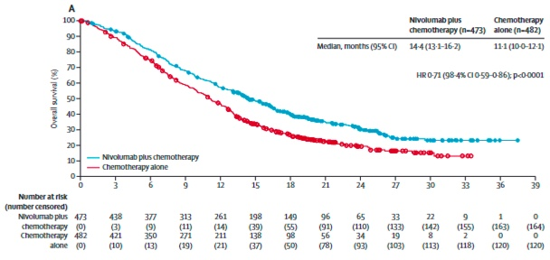
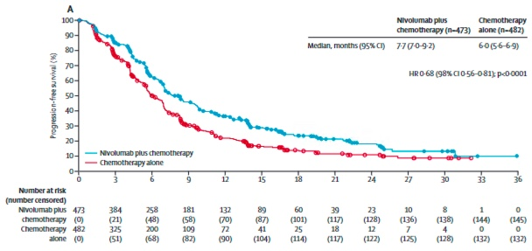
Front-line checkpoint inhibitor therapy—CHECKMATE 649
Patients with unresectable, advanced or metastatic gastric, GEJ or esophageal adenocarcinoma with no prior treatment; Her2 neg
Nivolumab 1mg/kg + Ipilimumab 3mg/kg
every 3W x 4, then nivo 240 mg every 2W
n=789
Nivolumab 360 mg + XELOX every 3W or
Nivolumab 240 mg + FOLFOX every 2W
Dual Primary Endpoints
Overall Survival in CPS ≥ 5
Progression Free Survival in CPS ≥ 5
n=792
XELOX every 3W or FOLFOX every 2W
Stratified by PD-L1 status, region,
ECOG PS and chemo
Overall Survival in CPS ≥ 5
Progression Free Survival in ≥ 5
Adapted from Moehler M, et al, 2021 ASCO Annual Meeting;
Janjigian YY, et al. Lancet 2021

Slide 8
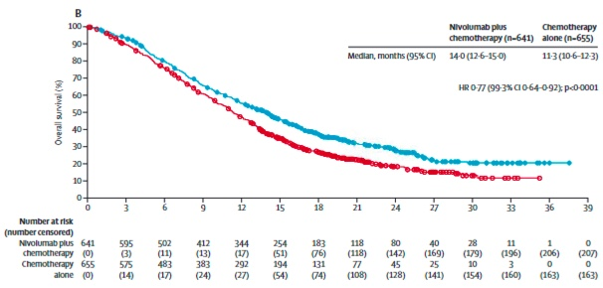
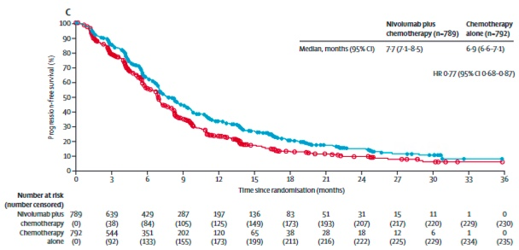
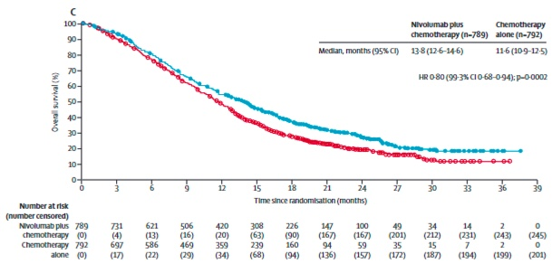
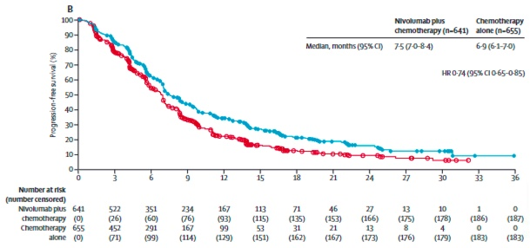
Front-line checkpoint inhibitor therapy shows positive overall survival for all patients
Overall Survival in CPS ≥ 1
Progression Free Survival in ≥ 1
Overall Survival in all patients
Progression Free Survival in all patients
Janjigian YY, et al. Lancet 2021

Slide 9
KEYNOTE-590
Patients with unresectable, advanced or metastatic esophageal and Siewert type I GE junctional cancer, both squamous cell carcinoma and adenocarcinoma
Cisplatin and 5-fluorouracil chemotherapy plus pembrolizumab 200 mg
every 3 weeks
Cisplatin and 5-fluorouracil chemotherapy plus placebo
every 3 weeks
n=749
Multiple primary endpoints:
Overall survival in patients with squamous cell carcinoma and CPS ≥ 10
OS and progression free survival in patients with squamous cell carcinoma
OS and PFS in patients with CPS ≥ 10
OS and PFS in all randomized patients
Sun J-M, et al. Lancet 2021

Slide 10
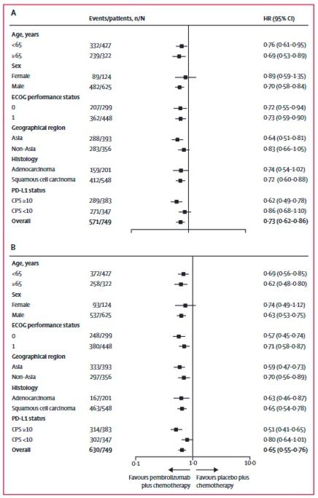
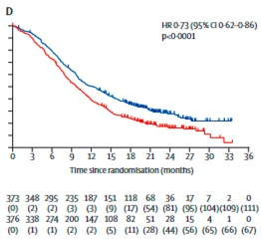
Survival Outcomes Favorable for all Primary Groups KEYNOTE-590
Trial was positive for all primary endpoints
Subgroup analysis showed improved PFS for adenocarcinoma population
Study was not powered to detect differences in adenocarcinoma patients specifically
Overall Survival in all randomized patients
Sun J-M, et al. Lancet 2021

Slide 11
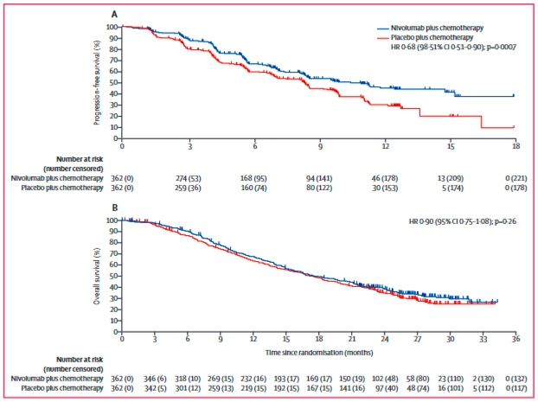
Favorable Progression Free Survival in ATTRACTION-4
Patients with unresectable, advanced or metastatic gastric or gastroesophageal junction adenocarcinoma, Her2 negative
Oxaliplatin and either capecitabine or S-1 chemotherapy plus nivolumab 360 mg every 3 weeks
Oxaliplatin and either capecitabine or S-1 chemotherapy plus nivolumab 360 mg every 3 weeks
n=724
Significant improvement in PFS with immunotherapy (10.45 months vs 8.34 months favoring IO)
No improvement in OS but OS was also unusually long in this study at > 17 months
Kang Y-K, et al. Lancet Oncol 2022

Slide 12
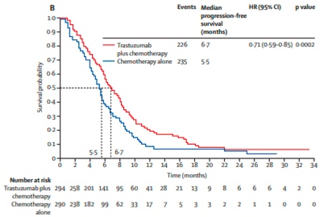
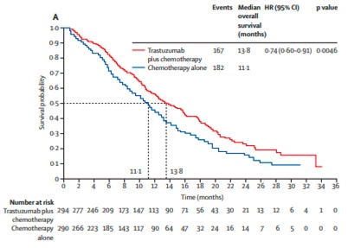
Front-line Chemotherapy in Her2 positive Gastric Cancer
Treatment standard has been chemotherapy plus trastuzumab based on the TOGA trial
Is there a role for immune checkpoint inhibitor therapy in this population?
Bang Y-J, et al. Lancet 2010

Slide 13
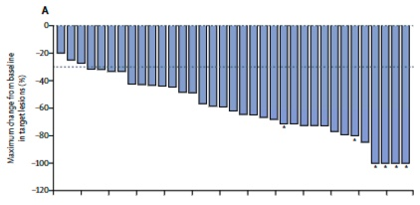
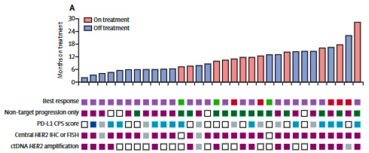
Chemotherapy plus trastuzumab plus immune checkpoint inhibitor therapy
Single arm phase II trial
37 patients
Treatment regimen
Pembro 200 mg + trastuzumab 8mg/kg loading dose, followed by
Platinum/fluoropyrimidine chemotherapy plus pembro 200 mg and trastuzumab 6 mg/kg every 3W
mPFS: 13.0 months
mOS: 27.3 months
ORR: 91%; DCR: 100%
Ongoing phase III trial
RR 74.4% with pembro vs 51.9% with placebo
Chemo/trastuzumab plus pembro approved and in NCCN guidelines
Janjigian YY, et al. Lancet Oncol 2020; Janjigian YY, et al. 2021 ASCO Annual Meeting

Slide 14
Case Presentation continued
Patient was treated with platinum/fluoropyrimidine plus pembrolizumab plus trastuzumab with improvement in his swallowing function and decrease in the size of all three lesions on imaging
Is there any role for surgery in this situation?

Slide 15
Case Presentation continued
Patient was treated with platinum/fluoropyrimidine plus pembrolizumab plus trastuzumab with improvement in his swallowing function and decrease in the size of all three lesions on imaging
After 15 months of treatment, patient was noted to have disease progression on imaging with development of additional liver metastases and abdominal lymphadenopathy
Is there any role for surgery in this situation?

Slide 16
DESTINY—Gastric01
Patients with unresectable, advanced or metastatic gastric or GEJ adenocarcinoma, Her2 positive and with progression on ≥ 2 lines of fluoropyrimidine and platinum containing chemotherapy
Trastuzumab deruxtecan IV every 3 weeks
n=126
Trastuzumab deruxtucan is an antibody-drug conjugate where an anti-Her2 antibody is attached to a topoisomerase I inhibitor payload
Physician choice chemotherapy (irinotecan or paclitaxel)
n=62
Response Rate: 51.3% with Trastuzumab deruxtecan vs 14.3% with chemotherapy
Disease Control Rate: 85.7% vs 62.5%
Progression Free Survival: 5.6 months vs 3.5 months
Overall Survival: 12.5 months vs 8.9 months
Received FDA approval for treatment in the second line setting
Shitara K, et al, N Engl J Med 2020

