Slide 1
Rapid Treatment of Anemia
Allison Zibelli, MD

Slide 2
Conflicts of Interest

Slide 3
Current state of outpatient anemia treatment

Slide 4
Case #1
A 52-year-old woman presents to her primary care physician for a yearly wellness visit. Routine labs are drawn.
The next day, the results of the CBC are reported. The hemoglobin is 7.5 g/dL.

Slide 6
Disadvantages of delayed anemia treatment

Slide 7
Problems with current care model
Relies on primary care to assess urgency of treatment
Overuse of ED
Delayed treatment
Wastage of blood
Missed diagnosis
Unnecessary hospitalization
Patient dissatisfaction

Slide 8
Pain points for primary care
Who to call?
Appointment delay
Typically, ED vs patient self-schedule

Slide 9
Anemia in the Emergency Room

Slide 10
Sources of patient pain in the ED

Slide 11
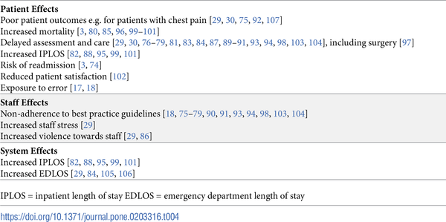
Table 4. Studies reporting consequences of ED crowding.
Morley C, Unwin M, Peterson GM, Stankovich J, Kinsman L (2018) Emergency department crowding: A systematic review of causes, consequences and solutions. PLOS ONE 13(8): e0203316. https://doi.org/10.1371/journal.pone.0203316
https://journals.plos.org/plosone/article?id=10.1371/journal.pone.0203316

Slide 12
Patient experience in the ED

Slide 13
Closing the Referral Loop: an Analysis of Primary Care Referrals to Specialists in a Large Health System Malhar P. Patel BSPH, Priscille Schettini BS, Colin P. O’Leary BA, Hayden B. Bosworth PhD, John B. Anderson MD, MPH & Kevin P. Shah MD, MBA Journal of General Internal Medicine volume 33, pages715–721 (2018)

Slide 14
Wastage of blood

Slide 15
Wastage of Blood
40 year old woman, hemoglobin found to be 7.5 g/dL on admission for pneumonia
EGD and colonoscopy were negative
2 units PRBCs given
Eventual diagnosis: Sickle Cell-beta thalassemia

Slide 17
Their criteria for transfusion

Slide 19
No diagnosis
37 year old woman presented with shortness of breath and fatigue
Found to have a hemoglobin of 5.4 g/dL, MCV 64
Past medical history notable for SLE on Plaquenil
Given 3 units PRBCs in the hospital, LOS 2 days
Seen in ED 6 months prior, transfused 2 units, referred to GI
Eventual diagnosis was autoimmune hemolytic anemia

Slide 20
Closing the Referral Loop: an Analysis of Primary Care Referrals to Specialists in a Large Health System Malhar P. Patel BSPH, Priscille Schettini BS, Colin P. O’Leary BA, Hayden B. Bosworth PhD, John B. Anderson MD, MPH & Kevin P. Shah MD, MBA Journal of General Internal Medicine volume 33, pages715–721 (2018)

Slide 21
An "innocent bystander"?

Slide 22
Hospitalization in the mildly anemic

Slide 23
Death in the mildly anemic

Slide 26
Wrong treatment
68 year old male with gum bleeding s/p tooth extraction
Multiple co-morbidities including advanced liver disease
Transfused multiple times in the hospital with RBCs
Seen at Rapid Anemia Clinic, started on tranexamic acid with resolution of bleeding

Slide 27
No treatment
29 year old woman, 28 weeks pregnant
Previous infant was low birthweight
Hemoglobin 8.2g/dL, Ferritin 4
Taking prenatal vitamins as instructed

Slide 28
A neglected problem

Slide 29
Study population
228,438 deliveries in 19 US hospitals, 2002-2008
6.1% had anemia in pregnancy
Higher rates of severe maternal morbidity were more common after multivariate logistic regression analysis
Poor Apgar scores, neonatal ICU admission and neonatal death significantly higher in setting of anemia

Slide 30
Another study

Slide 31
Results of this study
Study population: All pregnant women in BC
12.8 % hemoglobin below 10.9g/dL
Anemia was associated with preterm birth, low birthweight, low Apgar score, neonatal and perinatal death

Slide 32
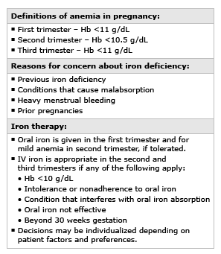

Slide 34
A New Model for Anemia Diagnosis and Treatment—the Rapid Anemia Clinic

Slide 35
Setting of intervention
Small community hospital in urban area
Outpatient Infusion Center, capacity for transfusions
2 hematologists, one NP
Dedicated precertification team

Slide 37
Rapid Anemia Workflow
Primary team finds anemia
Call/text to dedicated anemia team
NP evaluates labs
Patient seen and treated
Precert for treatment
Patient offered appointment within 2 days

Slide 38
Role of Nurse Practitioner
Identify and educate potential referral sources
Design rapid workflow with billing department to ensure precertification within 24 hours
Review labs and contact patient prior to visit to discuss the visit and expectations for treatment, order further labs as needed
Triage complex patients to physician

Slide 39
This is the only picture the NP would let me use
Us with Pro-Bowler Brandon Graham

Slide 40
Table 4. Studies reporting consequences of ED crowding.
Morley C, Unwin M, Peterson GM, Stankovich J, Kinsman L (2018) Emergency department crowding: A systematic review of causes, consequences and solutions. PLOS ONE 13(8): e0203316. https://doi.org/10.1371/journal.pone.0203316
https://journals.plos.org/plosone/article?id=10.1371/journal.pone.0203316

Slide 41
Our Experience

Slide 42
Most common referral sources

Slide 43
Hemoglobin at referral

Slide 44
Diagnoses seen in the Anemia clinic
Iron deficiency—210
Chronic Kidney disease—16
Anemia of Chronic Inflammation—8
Blood loss—6
Cancer—5
Thalassemia—4
Other—4 (B12, drug, vWD, Hep C)

Slide 45
Treatments given in Anemia Clinic
IV iron—197
Oral iron—17
No treatment—28
Erythropoietin—13
Transfusion—6
Other—4 (ED, chemo (2), B12)

Slide 46
Interval to Visit (Days)

Slide 47
Starting hemoglobin of pregnant patients

Slide 48
Results of Intervention
Referring physicians overwhelmingly satisfied
Unexpected referral sources
Transfusions much lower than inpatient/ED setting
Alternative diagnoses found
Preoperative patients treated before surgery

Slide 49
Future Directions

Slide 50
Room for improvement
Adding additional referral sources
Decrease time to visit
ER/inpatient diversion

Slide 51
Possible further projects
Anemia in pregnancy
Partnership with GI
Chronic renal failure
ED triage/diversion
CKD anemia clinic
Expand the empire

Slide 52
Questions?

