Slide 1
Gender and Racial Disparities in Melanoma Clinical Trials
Swe Swe Hlaing, MD, Melissa Wilson, MD
Crozer Keystone Health System
St. Luke’s University Health Network

Slide 2
Introduction
As per the Surveillance, Epidemiology and End Results (SEER) Program, the incidence of melanoma has been trending up.
However melanoma clinical trials do not include adequate representation of gender and race.

Slide 3
Methodology
Study type: Retrospective study
Source: ClinicalTrials.gov run by the US National Library of Medicine at the National Institute of Health
Inclusion Criteria: Filtered by using advanced criteria such as disease, study type (interventional clinical trial), study results (studies with results), status (completed), location (US), and phase (3 or 4).
Analysis: Descriptive statistics
Outcomes: number of gender and racial disclosures

Slide 4
Results
Total Sample Size: 35 studies
Total number of studies with gender disclosure: 35 (100%)
Men represent 58% and female represent 42%.
Total number of studies with racial disclosure: 18 (51.42%)
Caucasians made up the majority (96%) of the trial populations.
The rest of the racial distribution includes black (0.31%), Asian (1.34%), Hispanic (0.33%) and Others (1.78%).

Slide 5
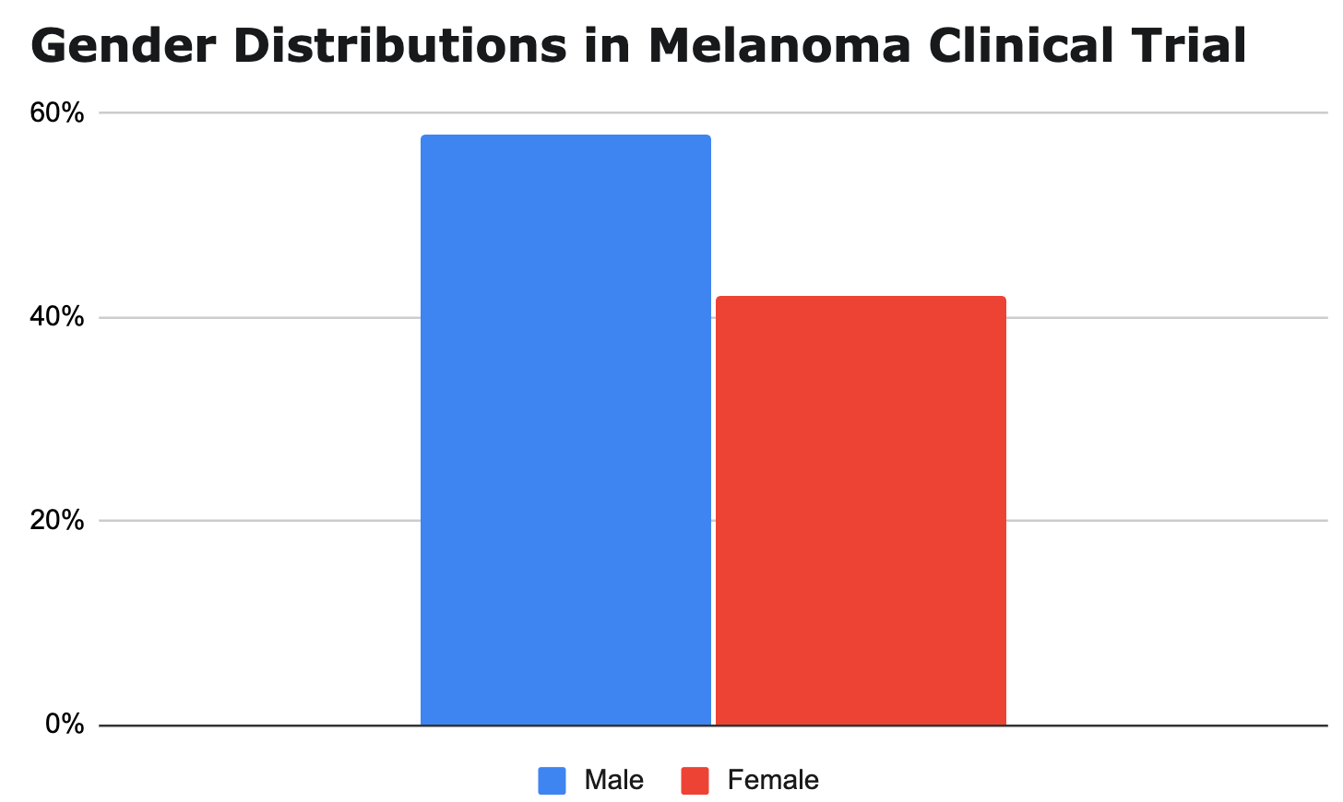

Slide 7
Conclusion
It is evident only half of the clinical trials were disclosing the racial demographic data of their study participants.
The overrepresentation of Whites as well as the male gender becomes discernible in comparison with US census.
Although Melanoma more commonly occurs in Caucasian males, it is prudent to include comprehensive racial data in clinical trials during today’s era of evidence-based medicine.
Generalizability is crucial as it results in tangible changes in practice and clinical management.

Slide 8
References
- clinicaltrials.gov
- https://seer.cancer.gov/statfacts/html/melan.html

Slide 9
THANK YOU!

